Slide 1

A Survey of Obstacle Recognition Implementations in Autonomous Vehicles
Group 3: Sharad Bhosale, Seth Gory, Vuong Hoang, Israel Nolazco

Slide 2
Outline
Introduction
Acoustic Sensors
Radar
Laser/LIDAR
Optical Sensors (Cameras)
Fusion Approach
Contemporary Techniques
Conclusion

Slide 3
Introduction

Slide 4
Introduction
Topic description:
Obstacle recognition within the field of autonomous vehicle control.
Obstacles include: people, other cars, potholes, construction signs, and more.

Slide 5
Introduction: Major Problems
Major problems the field is focused on:
Reliability and safety
Cost
Identifying obstacles
Identifying road signs
Inclement weather
Poor road surface conditions

Slide 6
Outline
Introduction
Acoustic Sensors
Radar
Laser/LIDAR
Optical Sensors (Cameras)
Fusion Approach
Contemporary Techniques
Conclusion

Slide 7
Acoustic Sensors

Slide 8
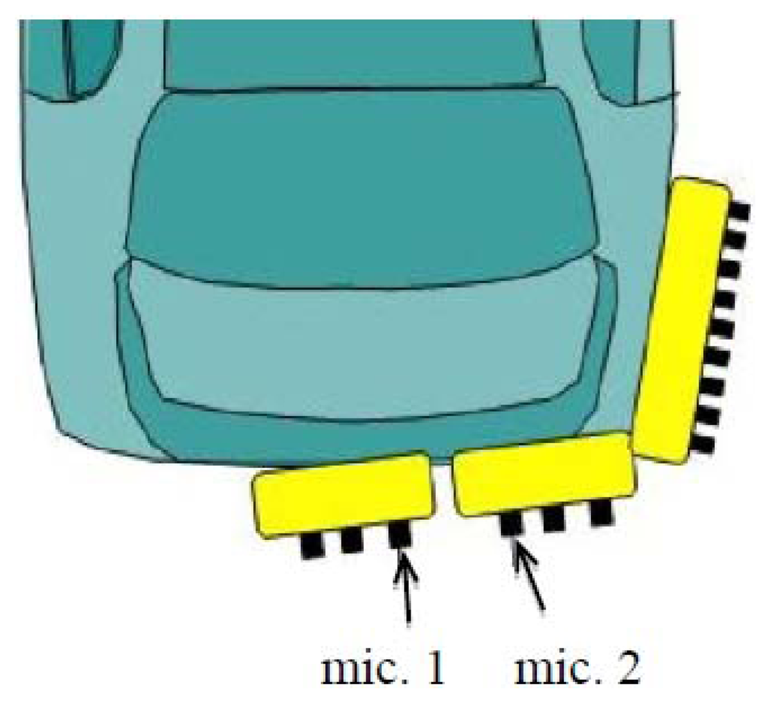
Acoustic Sensors
How does it work?
Multiple microphones detect acoustic signals
Onboard processing interprets signal
AI systems can become aware of an impreding collision
Ultrasound and normal microphones are used

Slide 9
Acoustic Sensors
Strengths | Weaknesses
Omni-directional, no blind spot Inexpensive Fast Processing | Short-range Major interference problems (road noise)

Slide 10
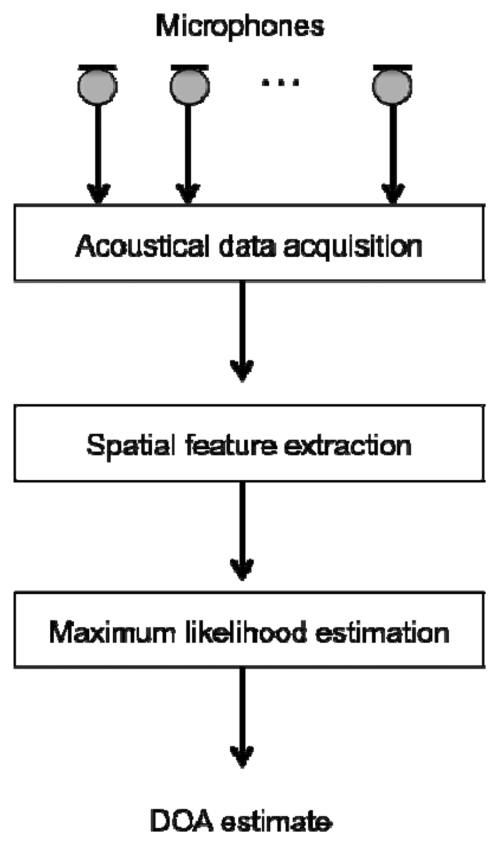
Acoustic Sensors
Major problems: interference from wind, varying road surfaces, engine sound, etc, makes it difficult to parse meaningful and important noises in the environment.
Spatial feature extraction to cut down on effect of noise.
Maximum Likelihood Estimator is used to assess the direction of an approaching collision risk.
Allows AI system to take evasive action or warn the driver.
Direction of Arrival Estimate
Mizumachi, Mitsunori, et al. "Robust sensing of approaching vehicles relying on acoustic cues." Sensors 14.6 (2014): 9546-9561.

Slide 11
Outline
Introduction
Acoustic Sensors
Radar
Laser/LIDAR
Optical Sensors (Cameras)
Fusion Approach
Contemporary Techniques
Conclusion

Slide 12
Radar

Slide 13
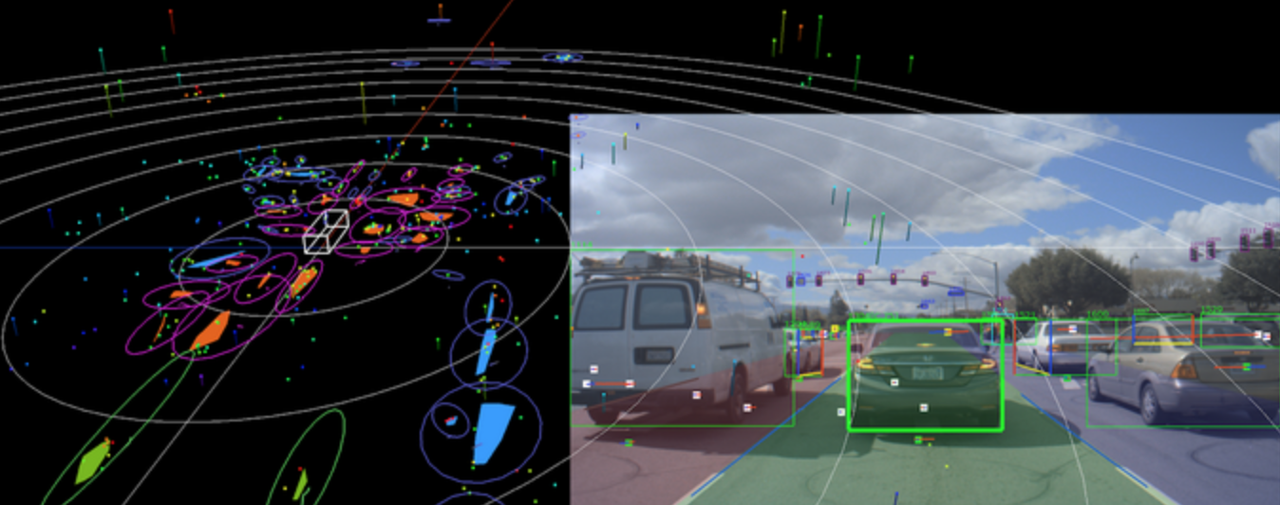
Radar
How does it work?
Radio waves are transmitted
Reflections received via receiver
Signal interpreted by processor
Can determine distance and speed of an object in the environment

Slide 14
Radar
Strengths | Weaknesses
Fast accurate distance and location Large range Not as affected by weather/light conditions | Expensive Difficult to classify objects Consumes more energy Some electronic interference issues

Slide 15
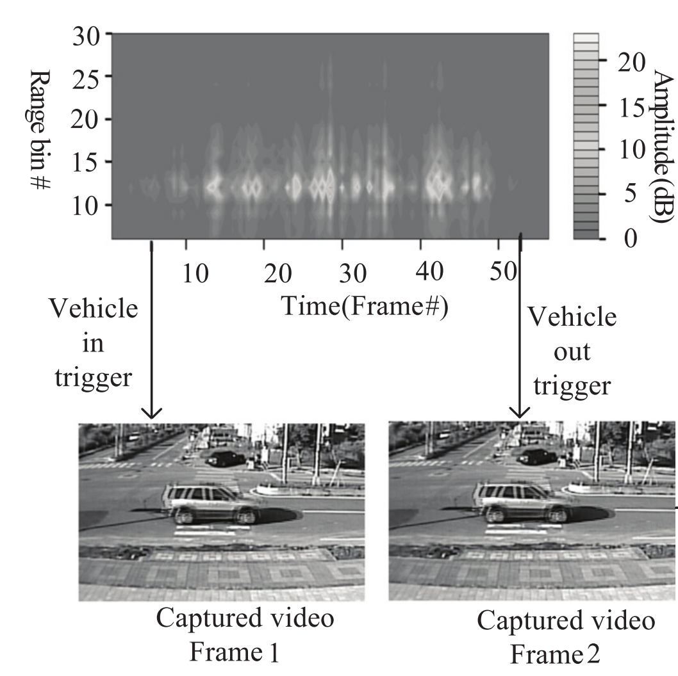
Radar
Use camera and image processing to determine vehicle type and speed labels.
Pair labels with radar signal.
Accuracies using radar to predict type and speed:
K-Means: 42%
LDA: 93%
SVM 94%
SVM was determined optimal when trained with processed image data to create a radar-based classifier
Cho, Hsun-Jung, and Ming-Te Tseng. "A support vector machine approach to CMOS-based radar signal processing for vehicle classification and speed estimation." Mathematical and Computer Modelling 58.1-2 (2013): 438-448.

Slide 16
Outline
Introduction
Acoustic Sensors
Radar
Laser/LIDAR
Optical Sensors (Cameras)
Fusion Approach
Contemporary Techniques
Conclusion

Slide 17
Laser/LIDAR

Slide 18
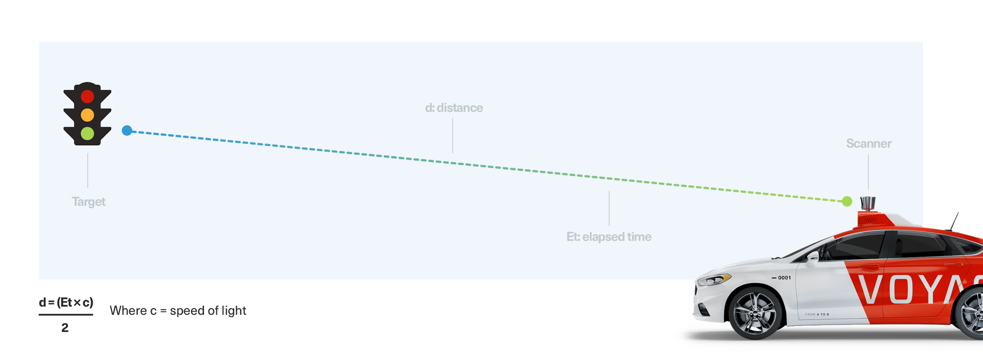
Laser/LIDAR
(Pic)
How does it work?
A system emits light by a laser and measures the reflection of light
This measurement gives the distance between an obstacle/object and the autonomous vehicle
It is similar to radar and versatile enough to be used in terrestrial and airborne applications.
Alternative application for LIDAR as object classifier

Slide 19
Laser/LIDAR
Strengths | Weaknesses
360º vision Accurate measurement (±2cm) Long-range (200m) | Expensive Only moderate performance in object detection/classification

Slide 20
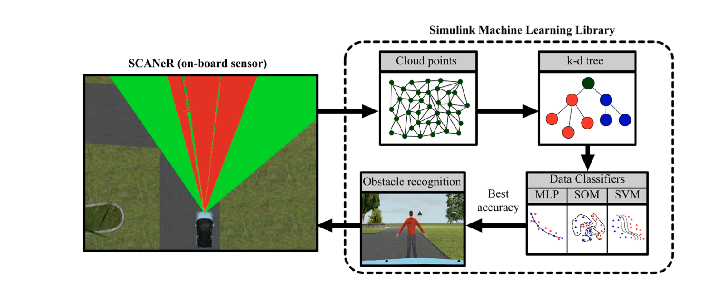
Laser/LIDAR
Obstacle Recognition using LIDAR
Pedestrian recognition is a key focal point in the safety features for autonomous vehicles
Utilizing Machine Learning and LIDAR obstacle recognition has improved drastically
The data captured was in Sunny condition; however, a simulated attempt was initiated with different weather conditions
Foggy conditions look promising, but further data is required
Overall attempts to create one solution that will cover obstacle recognition has gained momentum
Castaño, Fernando, et al. "Obstacle recognition based on machine learning for on-chip LiDAR sensors in a cyber-physical system." Sensors 17.9 (2017): 2109.

Slide 21
Outline
Introduction
Acoustic Sensors
Radar
Laser/LIDAR
Optical Sensors (Cameras)
Fusion Approach
Contemporary Techniques
Conclusion

Slide 22
Optical Sensors (Cameras)

Slide 23
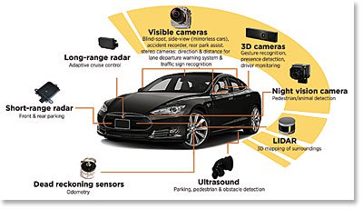
Optical Sensors
How does it work?
Cameras placed on every side of the vehicle for 360º view (no blind-spot)
Specialty cameras used: night-vision, 3D cameras, wide-angle (120º), fish-eye
Deep learning interprets real-time feed from multiple cameras
Can be used to interpret text on road signs
Internal cameras used for driver monitoring

Slide 24
Optical Sensors
Strengths | Weaknesses
Rich visual information Reliable Inexpensive Low-light sensitivity, high dynamic range (HDR) Not sensitive to temperature variation | Snow, mud, dirt, and fog impacts performance Sun glare can impact performance

Slide 25
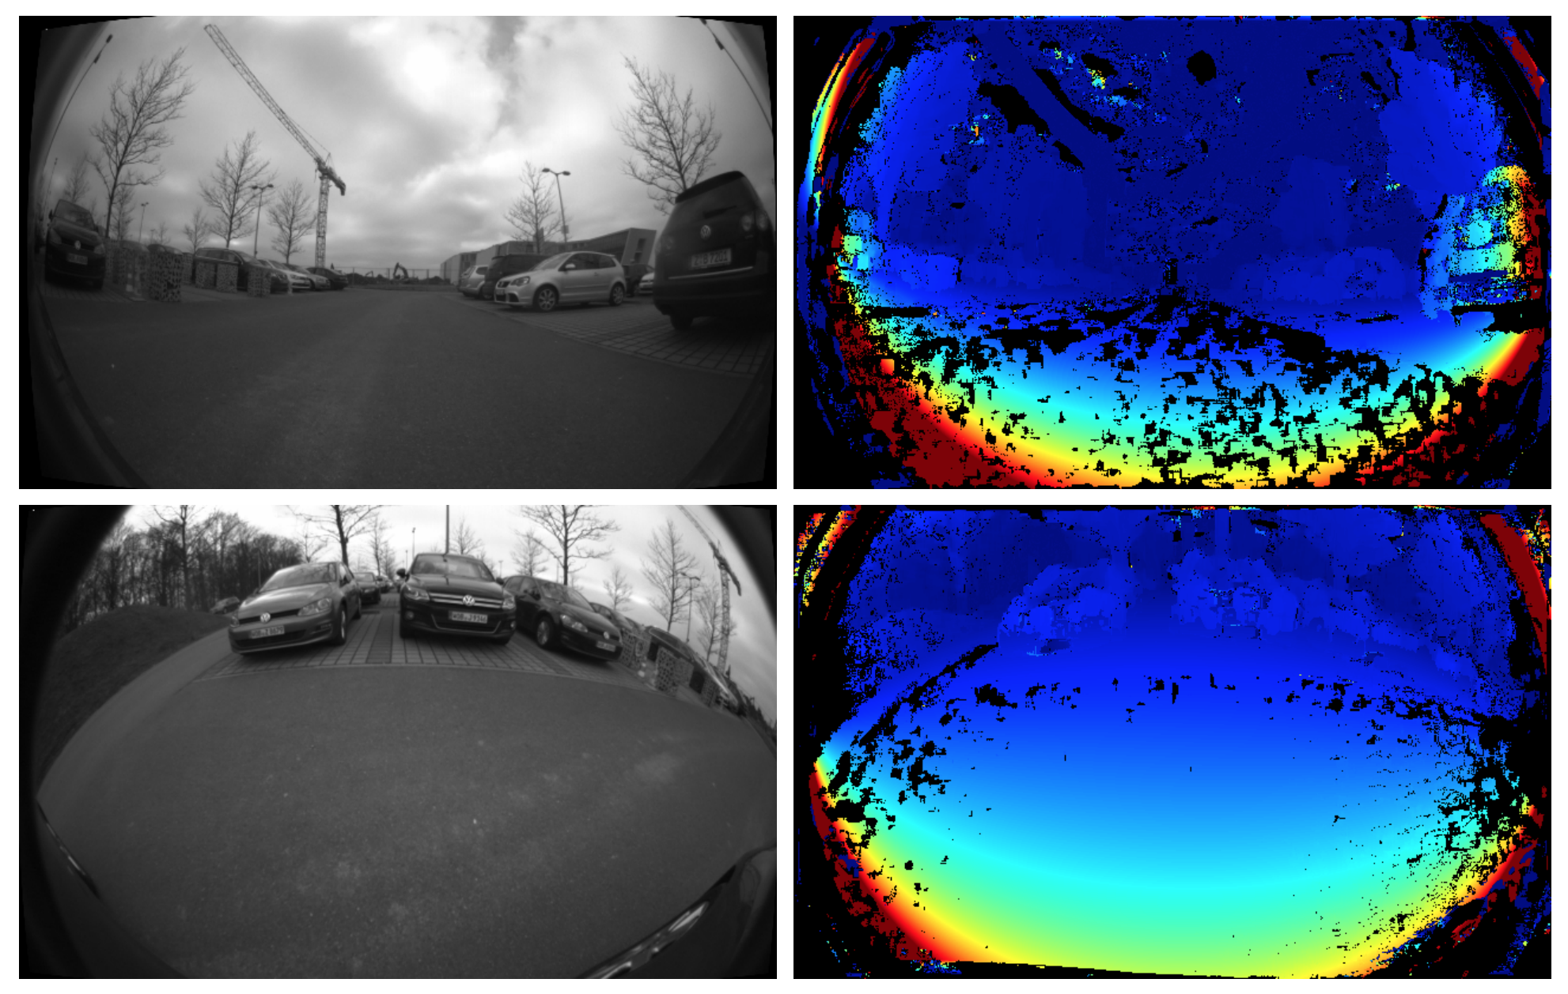
Optical Sensors
This research comes out of a project to automatically valet and charge electric cars (V-Charge).
Multiple fish eye cameras are used to capture 360º.
Fewer cameras reduces cost.
Previous applications interpret data from multiple cameras independently to locate obstacles.
The proposed system takes into account the feed from multiple cameras for Simultaneous Localization and Mapping (SLAM).
Allows for very accurate location estimations by employing depth mapping with each camera.
Multi-camera approach is essentially 3D vision.
Results in a robust obstacle detection system.
Häne, Christian, et al. "3D visual perception for self-driving cars using a multi-camera system: Calibration, mapping, localization, and obstacle detection." Image and Vision Computing 68 (2017): 14-27

Slide 26
Outline
Introduction
Acoustic Sensors
Radar
Laser/LIDAR
Optical Sensors (Cameras)
Fusion Approach
Contemporary Techniques
Conclusion

Slide 27
Fusion Approach

Slide 28
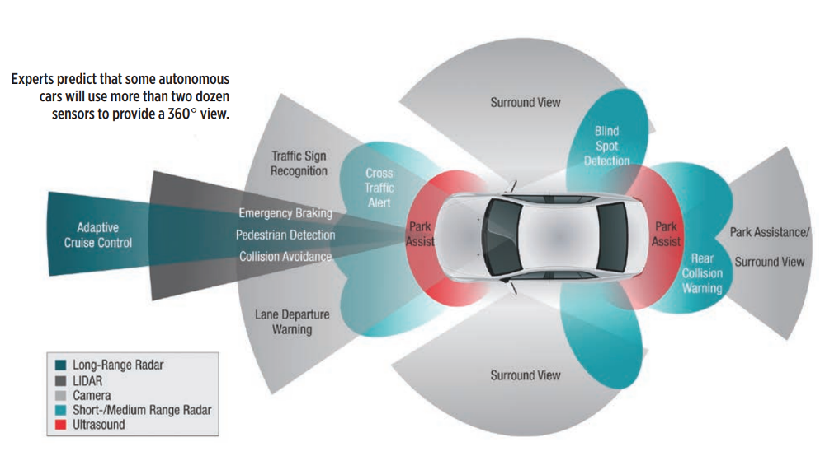
Fusion Approach
How does it work?
Multi-modal sensing combines several approaches
Each sensor type’s percepts are combined and used to maintain robust awareness of the environment.
Different sensor types for specific sub-tasks.

Slide 29
Fusion Approach
Strengths | Weaknesses
Robust and reliable Sensing environment across multiple mediums Combine strengths of other methods while abating weaknesses | Different algorithms control each sensor The need for a meta-algorithm that takes into account multiple sensors High complexity Expensive

Slide 30
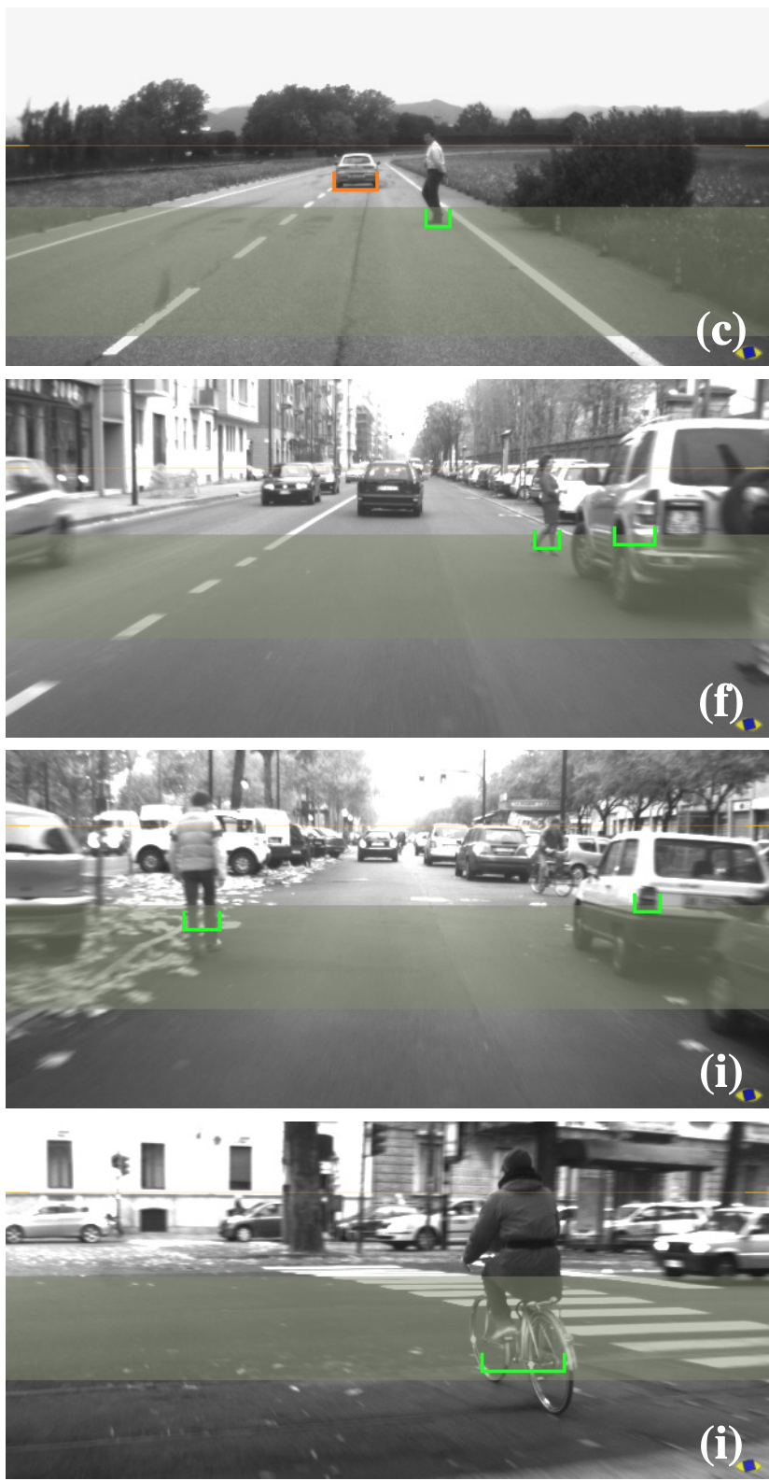
Fusion Approach
Visual data from standard RGB cameras is taken simultaneously with radar data.
Highly reliable detection and classification system is produced by combining the two methods.
Camera refines the boundaries of objects.
Radar pinpoints distance, direction and speed of travel of another object on the road.
Improved ability to detect pedestrians.
Bertozzi, Massimo, et al. "Obstacle detection and classification fusing radar and vision." 2008 IEEE Intelligent Vehicles Symposium. IEEE, 2008.

Slide 31
Outline
Introduction
Acoustic Sensors
Radar
Laser/LIDAR
Optical Sensors (Cameras)
Fusion Approach
Contemporary Techniques
Conclusion

Slide 32
Contemporary Techniques

Slide 33
Contemporary Techniques
We are going to look at current autonomous car systems/manufacturers to understand current state of technology.
Waymo
Cameras ,LiDAR, Radar, Microphones and GPS
Tesla
Cameras, Radar, Ultrasonic sensors and GPS
GM Cruise
Cameras, LiDAR, Radar, Microphones and GPS
Argo AI
Cameras, LiDAR, Radar, Microphones and GPS
Baidu
Cameras, LiDAR, Radar, Microphones and GPS
Starship Food Delivery Robot
Cameras, Radar, Ultrasonic sensors and GPS

Slide 34
Outline
Introduction
Acoustic Sensors
Radar
Laser/LIDAR
Optical Sensors (Cameras)
Fusion Approach
Contemporary Techniques
Conclusion

Slide 35
Conclusion

Slide 36
Conclusion
Fusion approach offers the most reliable obstacle detection.
Most expensive and complex approach.
State of the art automobile applications all use a fusion of sensors (Tesla, Waymo, etc).
Not always needed for factory/warehouse applications (Amazon).
Weather can make Camera or LIDAR sensors fail, but Radar makes up for it.
ML techniques (SVM, kNN, CNN, etc.) are used to combine different sensor data in order to classify obstacles. Influences AI decisions.

Slide 37
Conclusion
Camera and Radar most effective for sensing obstacles at far distances.
Acoustic and LIDAR sensors most effective for short range obstacle detection.
Radar, Camera, LIDAR used independently or in combination for obstacle classification.
Acoustic sensors poor at classification.

Slide 38
Outline
Introduction
Acoustic Sensors
Radar
Laser/LIDAR
Optical Sensors (Cameras)
Fusion Approach
Contemporary Techniques
Conclusion

Slide 39
References
Mizumachi, Mitsunori, et al. "Robust sensing of approaching vehicles relying on acoustic cues." Sensors 14.6 (2014): 9546-9561.
Cho, Hsun-Jung, and Ming-Te Tseng. "A support vector machine approach to CMOS-based radar signal processing for vehicle classification and speed estimation." Mathematical and Computer Modelling 58.1-2 (2013): 438-448.
Ipek, S. and Kapusta, R., 2020. LIDAR For Autonomous System Design: Object Classification Or Object Detection? | Analog Devices. [online] Analog.com. Available at: <https://www.analog.com/en/analog-dialogue/articles/lidar-for-autonomous-system-design-object-classification-or-object-detection.html#> [Accessed 5 October 2020].
Castaño F, Beruvides G, Haber RE, Artuñedo A. Obstacle Recognition Based on Machine Learning for On-Chip LiDAR Sensors in a Cyber-Physical System. Sensors (14248220). 2017;17(9):2109. doi:10.3390/s17092109
Häne, Christian, et al. "3D visual perception for self-driving cars using a multi-camera system: Calibration, mapping, localization, and obstacle detection." Image and Vision Computing 68 (2017): 14-27.
Daraeihajitooei, Mohammadhossein. Tightly-Coupled LiDAR and Camera for Autonomous Vehicles. Diss. UC Santa Cruz, 2018.
Bertozzi, Massimo, et al. "Obstacle detection and classification fusing radar and vision." 2008 IEEE Intelligent Vehicles Symposium. IEEE, 2008.
Md. Tanvir Hossan, Mostafa Zaman Chowdhury, Moh. Khalid Hasan, Md. Shahjalal, Trang Nguyen, Nam Tuan Le, Yeong Min Jang, "A New Vehicle Localization Scheme Based on Combined Optical Camera Communication and Photogrammetry", Mobile Information Systems, vol. 2018, Article ID 8501898, 14 pages, 2018.
Häne, Christian, et al. "3D visual perception for self-driving cars using a multi-camera system: Calibration, mapping, localization, and obstacle detection." Image and Vision Computing 68 (2017): 14-27
Yu, Xiaoyan, and Marin Marinov. "A Study on Recent Developments and Issues with Obstacle Detection Systems for Automated Vehicles." Sustainability 12.8 (2020): 3281.

Slide 40
Thank You!

